Slide 1

Opportunity cost
1.1.1 The economic problem

Slide 2
1.1.1 The economic problem - What we learn
The problem of scarcity – where there are unlimited wants and finite resources, leading to the need to make choices.
Opportunity cost and its effect on economic agents (consumers, producers and government).
The use of diagrams to show production possibility curve.
Production possibility curve diagram should be used to show:
the maximum productive potential of an economy
fully employed or unemployed resources
opportunity cost
positive or negative economic growth that shifts the production possibility frontier (PPF) outwards and inwards
possible and unobtainable production.
e) Possible causes of positive or negative economic growth.

Slide 3

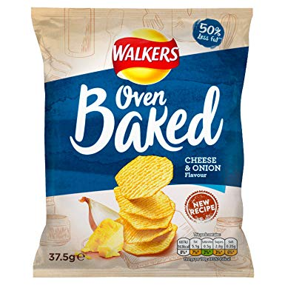
What would you choose?
Choosing one means giving up another

Slide 4


What would you choose?
Choosing one means giving up another

Slide 5
Opportunity costs
...are a trade-off.
When making a choice you will have to give up something else (the next best option).
Opportunity cost is the benefits lost of the next best alternative (the option you did not choose).

Slide 6

Opportunity costs
In economics decisions need to be made!
When an economic choice is made, opportunity costs is the benefit lost from choosing the next best alternative.
Notes:
https://www.youtube.com/watch?v=NwOYLV-L7pc
https://https://www.youtube.com/watch?v=NwOYLV-L7pc
www.youtube.com/watch?v=NwOYLV-L7pc

Slide 7
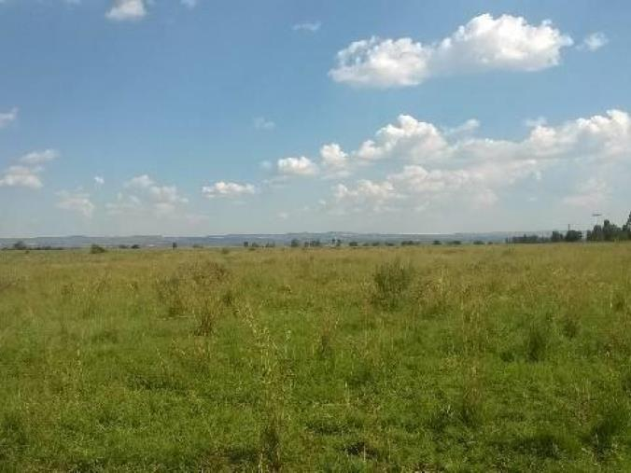
What could a piece of land be used for?
What is the opportunity cost?
Notes:
Grow crops provide food
Housing to provide homes
Infrastructure / road space
Windmills - energy

Slide 8
What is the opportunity cost?
A consumer is deciding to buy a new bicycle
A family has decided to save $500 every month towards a holiday next year
An employee has decided to quit her job
The government has decided to spend $10 billion on a new airport

Slide 10
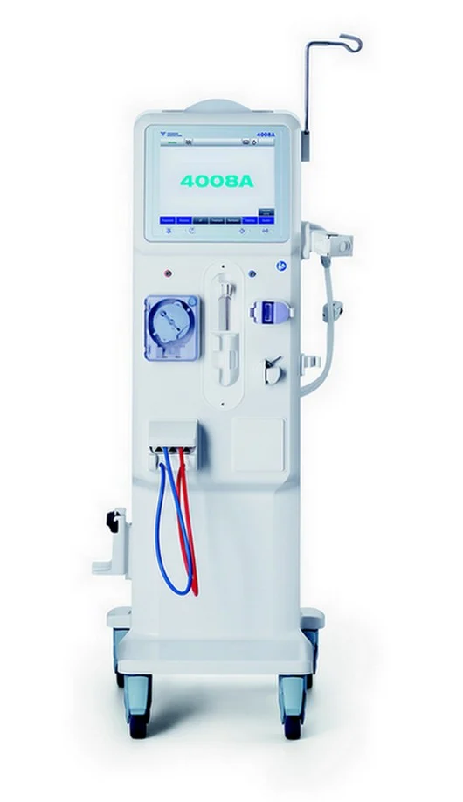
What would you do?
A hospital in a town has one dialysis machine that can run for 30 hours per week. As the boss of the hospital, you must decide who gets the treatment.
There are a number of patients who require treatment and their needs are given on the distributed sheet.
Make your choice.
Notes:
Starter - hand out the sheet

Slide 11

Task
A commercial bank in India operates 600 branches. The bank is expanding rapidly but is short of funds to meet all its spending plans. It has 7 billion rupees (about 1 billion HK$) to spend and the bank has drawn up a list of spending desires in order of preference :
Open 50 new branches
Renew all ATM machines
Buy an insurance company
Retrain all staff
Using this case as an example explain in a paragraph what is meant by an opportunity cost.

